Slide 1
Mobile Motor Mountain Climber
By: Jason Squared (Jason Mashieh and Jason Jeong)

Slide 2
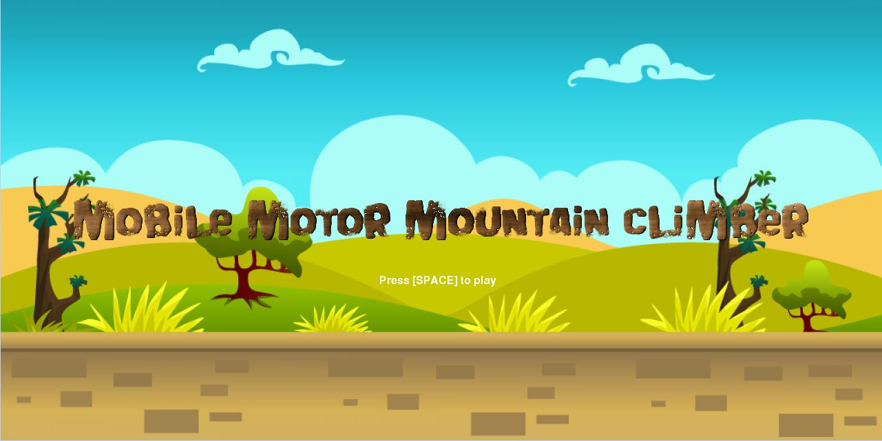
Objective
Notes:
So, the objective of our game is a player will use the space bar , left key, and right key to navigate in the game. The more the car stays on each platform the more points the player loses. On the other hand if the player keeps jumping with the car using the space bar, you lose no points as the car is in air. Once a player reaches 300 points by collecting gas cans. This game really does cause the player to experience excitement when a player wins and on the other hand a player can experience anger when losing the game.

Slide 3
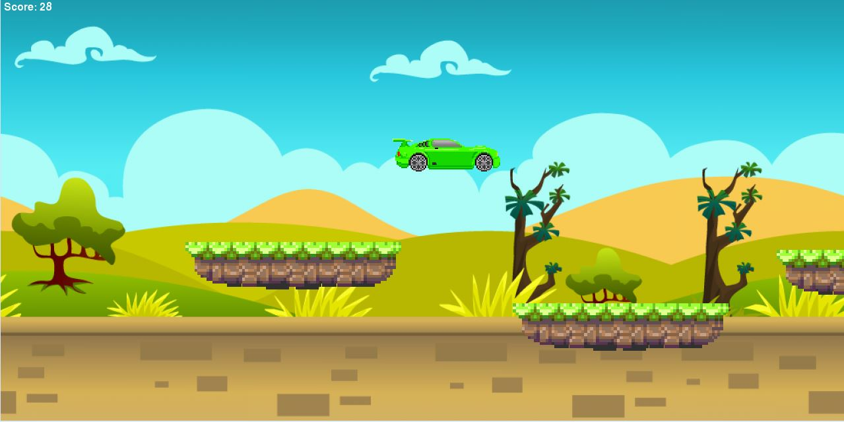
Game Mechanics
Notes:
The game will be a side scroller game, in which as time progresses, the background and platforms increase in speed.
The player will interact with the game through use of the keyboard. The left and right keys slow and speed up the car. The space bar will make the car jump
There will be gaps or throughout the game which the user will have to jump over. If the player fails to jump over the spaces/gaps the player will lose the game.

Slide 4


Are You a Winner or Loser?
Notes:
You win by collecting gas cans which give you points, therefore once you reach 300 points the game will end with a splash screen stating, “ YOU WIN!”. On the other hand a player may lose my falling through the spaces within the platform, therefore another message will pop up stating, “YOU LOSE!”.

